Slide 1


APPLIED DATA SCIENCE
SOWMIYA SAKTHIVEL
VVCET

Slide 2
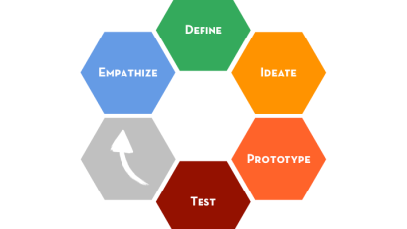
CREDIT CARD FRAUD DEDECTION
INTRODUCTION
PROBLEM DEFINITION
Importing the required libraries
Importing the data set
Encoding categorical data
Splitting the data set
Feature Scaling
DEEP LEARING
REAL-TIME MONITORING
IMPLANCED DATA HANDLING
DISCRIPTIVE ANALYSIST
ANOMALY DETECTION
PREDICTIVE ANALYSIST
NETWORK ANALYSIS
TIME SERIES ANALYSIS
CONCLUSION
This Photo by Unknown author is licensed under CC BY-NC-ND.

Slide 3

INTRODUCTION
Machine learning algorithms play a crucial role identifying fraudulent transactions by analyzing patterns and anomalies in credit card data.
Commonly used machine learning algorithms for credit card fraud detection include logistic regression, decision trees, random forests, and neural networks.
This Photo by Unknown author is licensed under CC BY-NC.

Slide 4

PROBLEM DEFINITION
The problem is to develop a machine learning-based system for
real-time credit card fraud detection.
The goal is to create a solution that can accurately identify fraudulent transactions
while minimizing false positives.
This project involves data preprocessing, feature engineering, model selection, training, and
evaluation to create a robust fraud detection systems

Slide 5
What the Credit Card Fraud Detection?
Credit card fraud is the act of using another person’s credit card to make purchases or request cash advances without the cardholder’s knowledge or consent.
These criminals may obtain the card itself through physical theft, though increasingly fraudsters are leveraging digital means to steal the credit card number and accompanying personal information to make illicit transactions

Slide 6
Types of credit card fraud
Credit card fraud falls into two basic categories:
1) Card present fraud
2) Card-not-present fraud

Slide 7

DIFFERENT ANALYSIS

Slide 8

Importing the required libraries(data.csv)
For credit card fraud detection, you would typically need libraries for data manipulation, visualization, and machine learning. Here are some common libraries that you might need:
pandas for data manipulation.
numpy for numerical operations.
matplotlib and seaborn for data visualization.
scikit-learn for machine learning tasks.
imbalanced-learn for handling imbalanced datasets, which is common in fraud detection.

Slide 9
import pandas as pd from sklearn.model_selection import train_test_split file_path = 'data.csv' data = pd.read_csv(file_path) data = pd.get_dummies(data, columns=['Category']) X = data.drop('Class', axis=1) y = data['Class'] X_train, X_test, y_train, y_test = train_test_split(X, y, test_size=0.2, random_state=42)
PROGRAM

Slide 10

Importing the data set(read data set;create matrix)
For credit card fraud detection, you typically have a dataset in a CSV format. You can import the dataset and create a matrix in Python using the pandas library to read the data and numpy to create a matrix. Here's a simple example:

Slide 11
import pandas as pd
import numpy as np
file_path = 'credit_card_data.csv'
data = pd.read_csv(file_path)
X = data.drop('Class', axis=1)
program

Slide 12

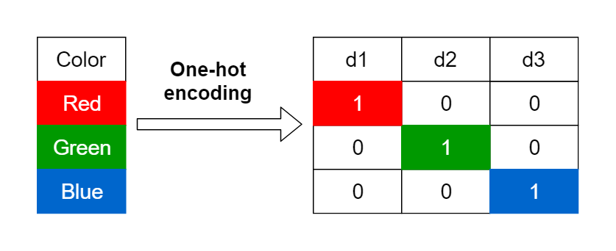
Encoding categorical data .(one - hot encoding)
To perform one-hot encoding for categorical data in a credit card fraud detection dataset, you can use the pandas
library. In this example, let's assume you have a column named 'Category' that contains categorical data, and you want to one-hot encode it:
This Photo by Unknown author is licensed under CC BY.

Slide 13
pip install scikit-learn import pandas as pd file_path = 'credit_card_data.csv' data = pd.read_csv(file_path) data = pd.get_dummies(data, columns=['Category'])
PROGRAM

Slide 14
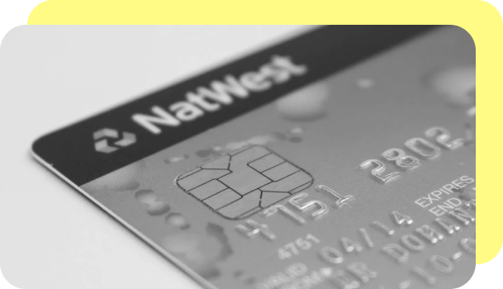
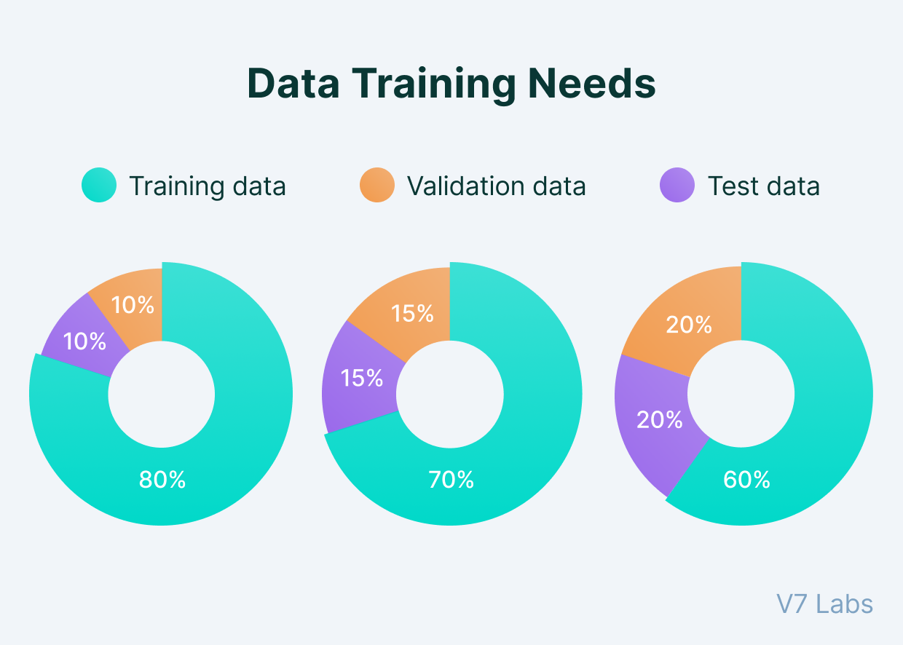
Splitting the data set into test set and training set
You can split your dataset into training and testing sets for credit card fraud detection using the train_test_split function from the scikit-learn library.

Slide 15
PROGRAM
import pandas as pd from sklearn.model_selection
import train_test_split
file_path = 'credit_card_data.csv'
data = pd.read_csv(file_path)
X = data.drop('Class', axis=1)
y = data['Class']
X_train, X_test, y_train, y_test = train_test_split(X, y, test_size=0.2, random_state=42)

Slide 16
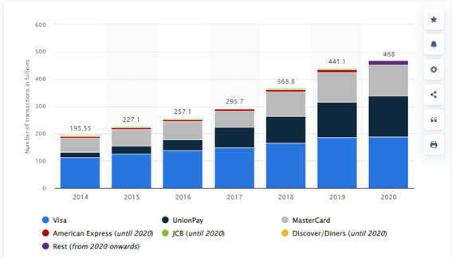
Feature Scaling.(import StandardScaler)
Feature scaling is an important preprocessing step in machine learning, including credit card fraud detection. You can use the StandardScaler from the scikit-learn library to scale your features.

Slide 17
import pandas as pd from sklearn.model_selection import train_test_split from sklearn.preprocessing import StandardScaler file_path = 'credit_card_data.csv' data = pd.read_csv(file_path) X = data.drop('Class', axis=1) Features y = data['Class'] X_train, X_test, y_train, y_test = train_test_split(X, y, test_size=0.2, random_state=42)
Program

Slide 18
Deep Learning for Fraud Detection
Explore advanced neural network architectures like convolutional neural
networks (CNNs) and recurrent neural networks (RNNs) for more
sophisticated feature extraction and time series analysis.
You can use deep learning models, such as a neural network,
to capture complex patterns in the data.

Slide 19
from tensorflow.keras.models import Sequential from tensorflow.keras.layers import Dense model = Sequential([ Dense(128, input_dim=X_train.shape[1], activation='relu'), Dense(64, activation='relu'), Dense(1, activation='sigmoid') ]) model.compile(optimizer='adam', loss='binary_crossentropy', metrics['accuracy']) model.fit(X_train, y_train, epochs=10, batch_size=32)
PROGRAM

Slide 20
Real-time Monitoring
To detect fraud in real-time, you can set up an automated system that continuously monitors incoming transactions and applies your trained model to identify anomalies.

Slide 21
from skmultiflow.classification
import HoeffdingTree
from skmultiflow.data import FileStream
# Define a stream data source (replace 'data_stream.arff' with your data source)
stream = FileStream('data_stream.arff', n_targets=2)
# Create an online learning model (Hoeffding Tree)
model = HoeffdingTree()
program

Slide 22
IMBALANCED DATA HANDLNG
Credit card fraud datasets are often imbalanced, with a majority of non-fraudulent transactions. You may need to use techniques
Like oversampling, under sampling, or Synthetic Minority Over-sampling Technique (SMOTE) to handle this imbalance.
This Photo by Unknown author is licensed under CC BY.

Slide 23
from imblearn.over_sampling import SMOTE sm = SMOTE(sampling_strategy=0.5) X_resampled, y_resampled = sm.fit_resample(X_train, y_train) # Train the model with the resampled data model.fit(X_resampled, y_resampled)
PROGRAM

Slide 24
Descriptive Analytics
Data Exploration:
Initial analysis to understand data characteristics.
Data Visualization:
Using charts to spot trends and patterns.

Slide 25
PROGRAM
# Data Exploration
legitimate_transactions.describe()
fraudulent_transactions.describe()
# Data Visualization import matplotlib.pyplot as plt plt.scatter(legitimate_transactions['amount'], legitimate_transactions['hour'],
label='Legitimate', color='green') plt.scatter(fraudulent_transactions['amount'], fraudulent_transactions['hour'], label='Fraudulent', color='red') plt.legend() plt.show()

Slide 26
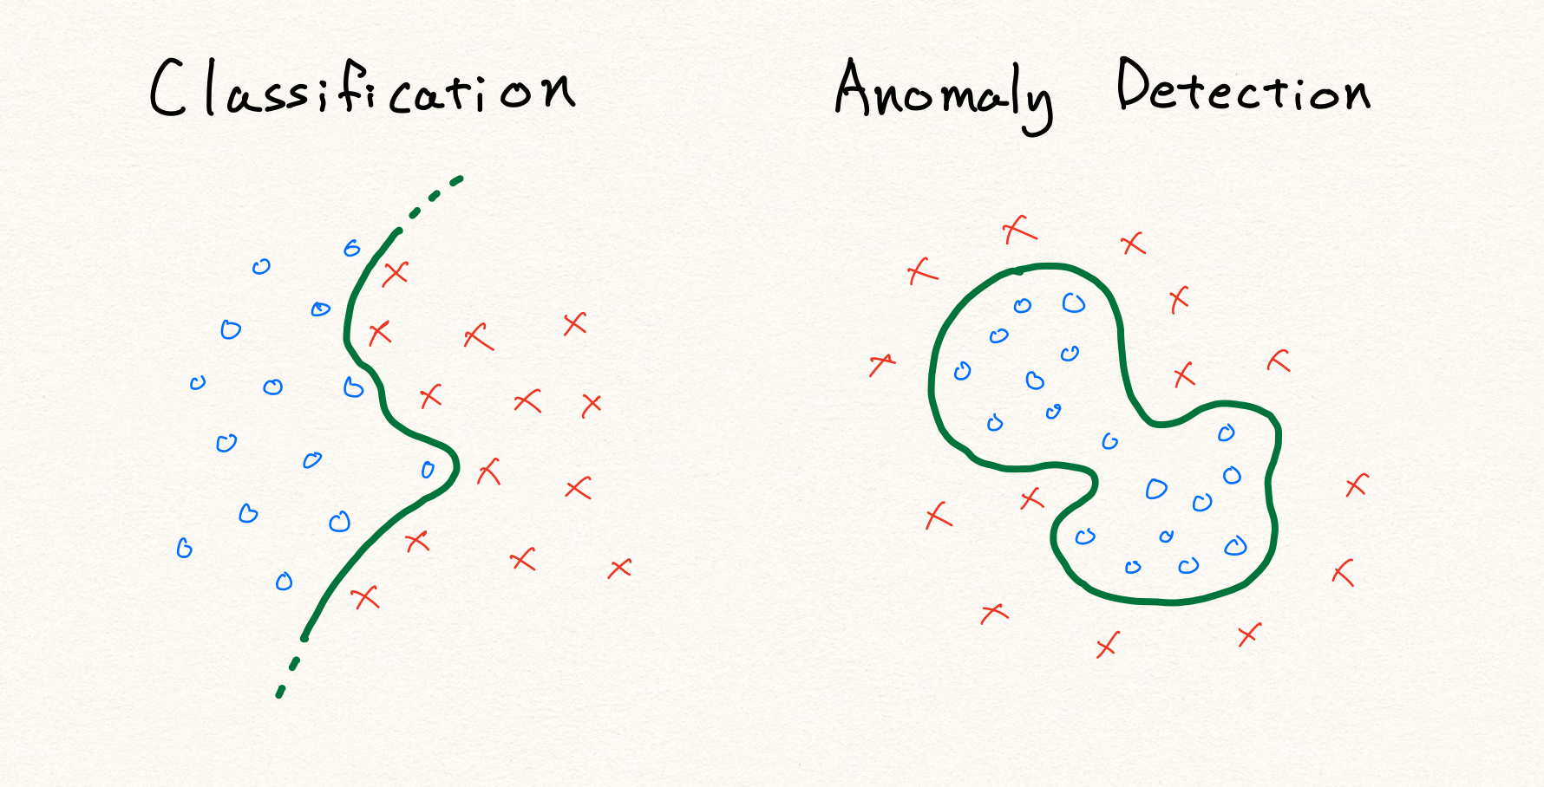
Anomaly Detection
Identifying outliers in data using Isolation Forest.
Set a contamination parameter for the expected proportion of outliers.

Slide 27
from sklearn.ensemble import IsolationForest clf = IsolationForest(contamination=0.05) clf.fit(X) # X is your transaction data predictions = clf.predict(X)
Program

Slide 28
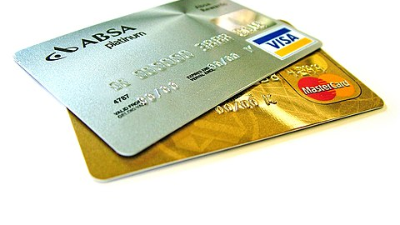
Predictive Analytics
Using logistic regression to predict fraud.
Split data into training and test sets for model evaluation.
This Photo by Unknown author is licensed under CC BY-SA.

Slide 29
Program: from sklearn.model_selection import train_test_split from sklearn.linear_model import LogisticRegression from sklearn.metrics import accuracy_score, confusion_matrix X_train, X_test, y_train, y_test = train_test_split(X, y, test_size=0.2) model = LogisticRegression() model.fit(X_train, y_train) predictions = model.predict(X_test) accuracy = accuracy_score(y_test, predictions) cm = confusion_matrix(y_test, predictions)

Slide 30
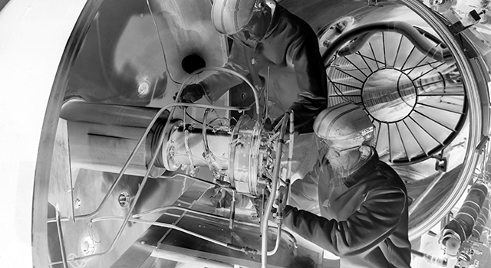
Rule-Based System
Define rules to classify transactions as legitimate or fraudulent.
Rules may be based on transaction amount, location, or other factors.
This Photo by Unknown author is licensed under CC BY-NC-ND.

Slide 31
Program: def rule_based_fraud_detection(transaction): if transaction['amount'] > 1000 and transaction['location'] not in trusted_locations: return "Fraudulent" else: return "Legitimate" result = rule_based_fraud_detection(transaction_data)

Slide 32
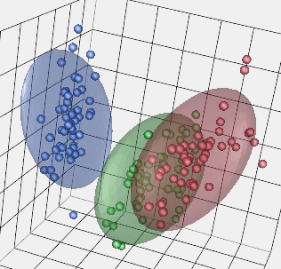
Unsupervised Learning (K-Means Clustering)
Grouping transactions into clusters.
Requires specifying the number of clusters.

Slide 33
PROGRAM
from sklearn.cluster
import KMeans kmeans = KMeans(n_clusters=2)
kmeans.fit(X) labels = kmeans.labels_

Slide 34
Deep Learning (Using TensorFlow and Keras)
Building a neural network model for fraud prediction.
Training the model using labeled data and an appropriate loss function.

Slide 35
PROGRAM: from tensorflow.keras.models import Sequential from tensorflow.keras.layers import Dense model = Sequential() model.add(Dense(64, input_dim=features, activation='relu')) model.add(Dense(1, activation='sigmoid')) model.compile(loss='binary_crossentropy', optimizer='adam') model.fit(X_train, y_train, epochs=10) predictions = model.predict(X_test)

Slide 36
Network Analysis:
Examining transaction networks and relationships to identify
patterns of fraud, especially in cases of organized fraud rings.

Slide 37
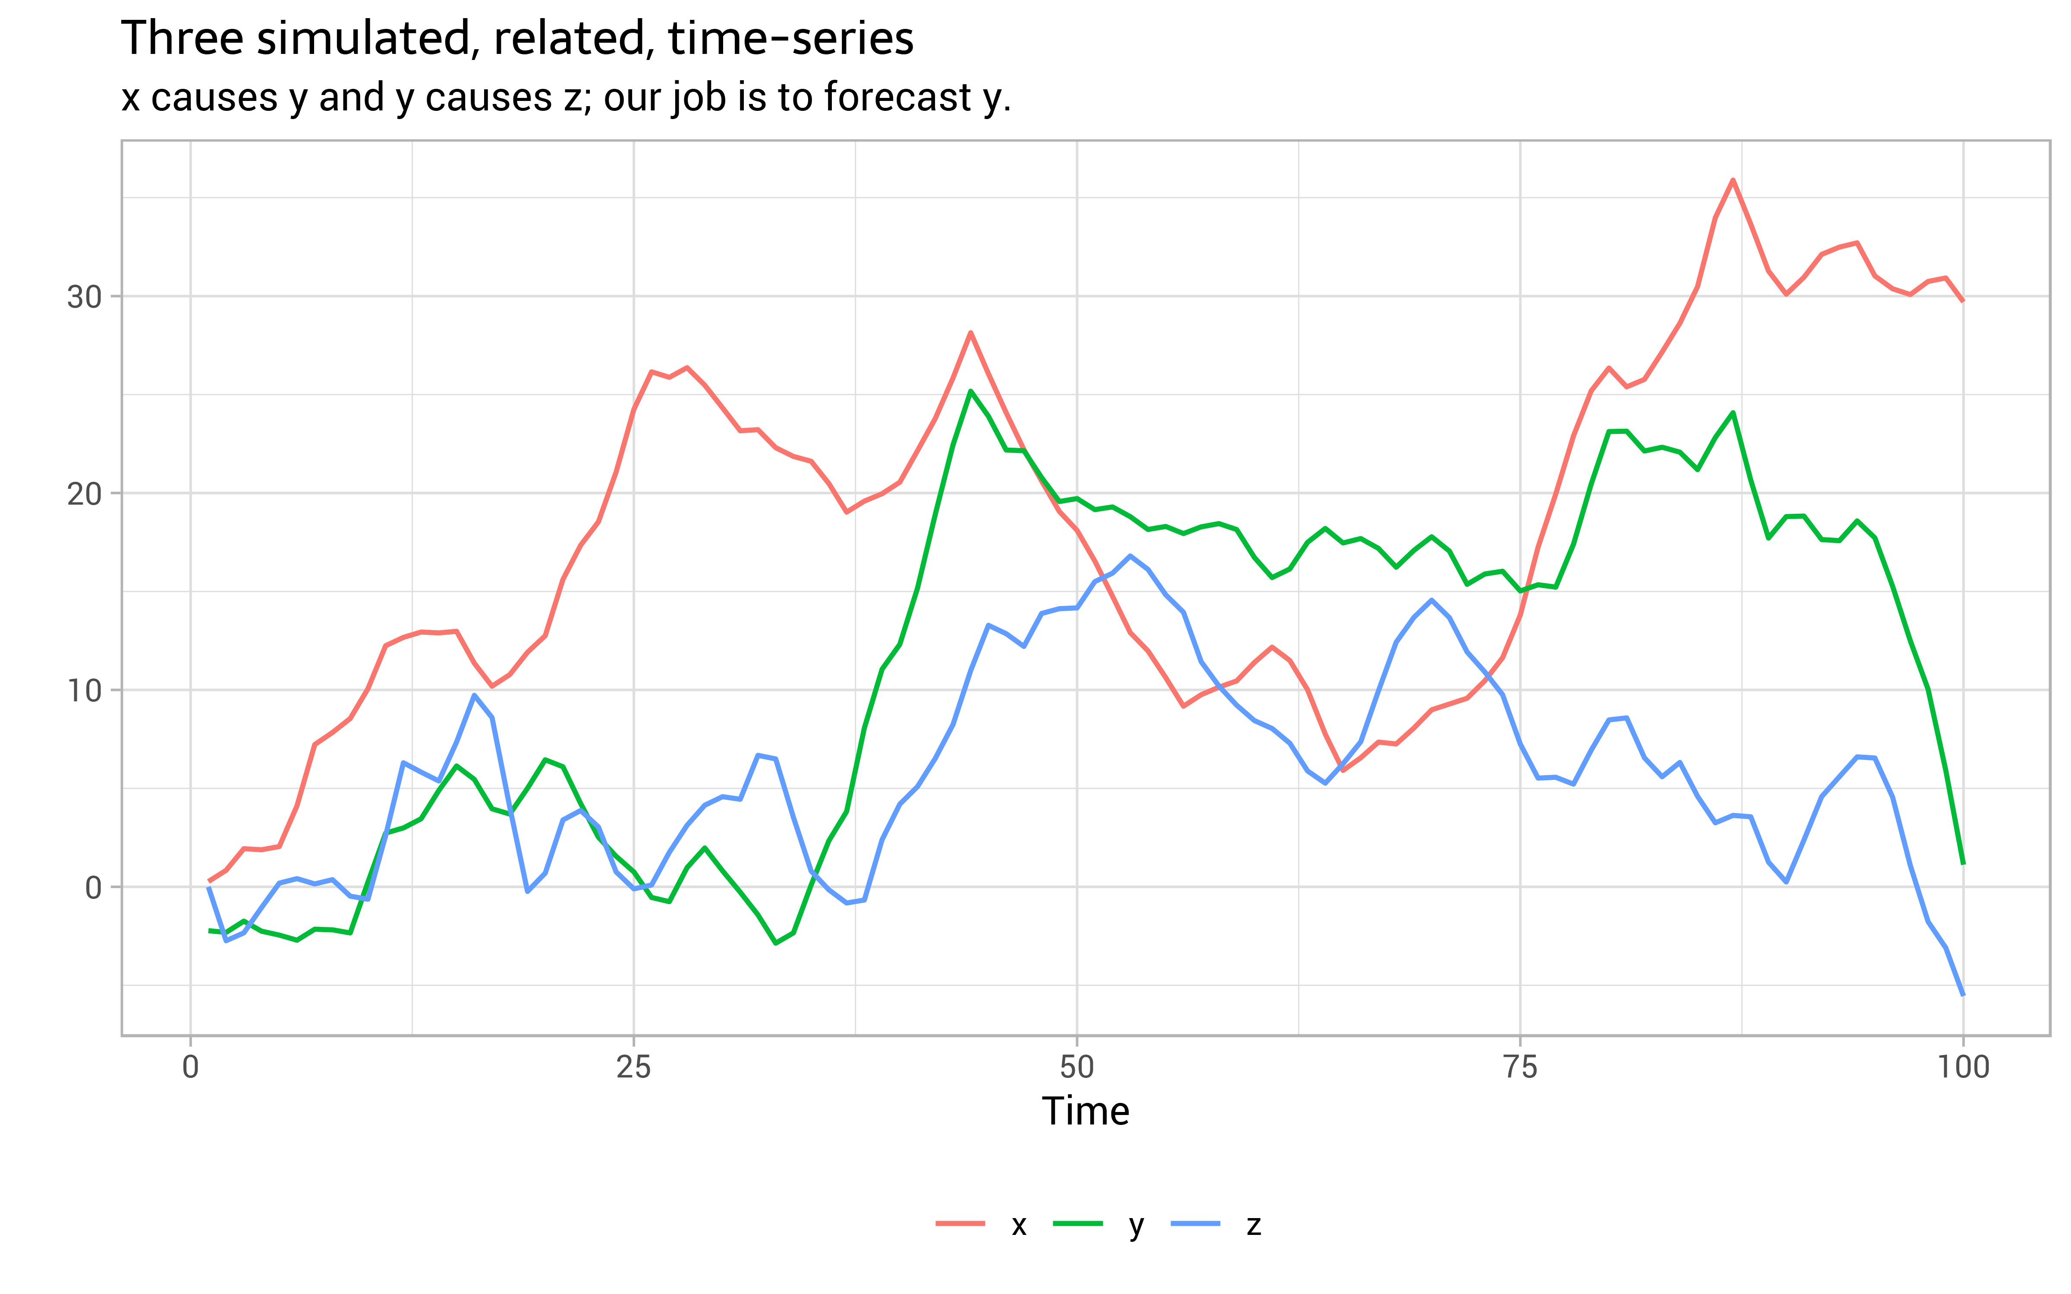
Time Series Analysis
Studying transaction time series data to detect anomalies and seasonality in fraud patterns.

Slide 38

THANK YOU

